Slide 1
VEHICLE ICONS
THIS PRESENTATION OF GRAPHIC ICON IMAGES WAS UPDATED 30 MAR 01. EXISTING IMAGES HAVE BEEN IMPROVED OR REPLACED AND ADDITIONAL IMAGES ADDED.
THE ICONS IN THIS PRESENTATION ARE PAINT (BITMAP IMAGES) THAT HAVE BEEN CONVERTED FOR POWER POINT USE. ALL ICONS ARE TO SCALE (1:100)
TO CHANGE SIZE OF ICONS, CLICK ON SELECTED ICON ONCE WITH LEFT MOUSE BUTTON. AT TOP OF SCREEN, SELECT “FORMAT”; SELECT “PICTURE/OBJECT”; SELECT “SIZE”. UNDER “SCALE”, CLICK ON “LOCK ASPECT RATIO” ONLY AND THEN INCREASE OR REDUCE SIZE WITH HEIGHT % BLOCK TO DESIRED SCALE. WIDTH WILL CHANGE AUTOMATICALLY TO CORRESPOND.
RECOGNITION AND APPRECIATION IS AFFORDED TO MR. DUANE KLUG, US ARMOR CENTER, FT KNOX, KY. FOR A LARGE PORTION OF THESE LATEST ADDITIONS, ARMOR AND ENGINEER EQUIPMENT IN PARTICULAR.
THESE GRAPHIC IMAGES WERE CREATED WITH GOVERNMENT EQUIPMENT AND MANPOWER. THEY ARE PROVIDED HERE AS “SHAREWARE” FOR FREE USE; HOWEVER, THEY MAY NOT BE COPIED OR REPRODUCED IN WHOLE OR IN PART AND SOLD FOR PROFIT.
GOOD QUALITY GRAPHIC IMAGES THAT COULD BE ADDED TO THIS COLLECTION MAY BE SENT TO gatesr@lee.army.mil. PLEASE INCLUDE A LINE NO., NOMENCLATURE OR MODEL FOR EACH, IF POSSIBLE.

Slide 2
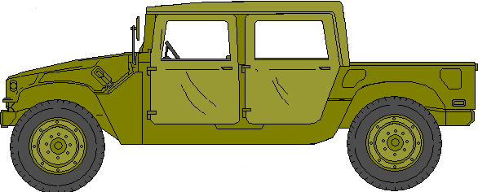
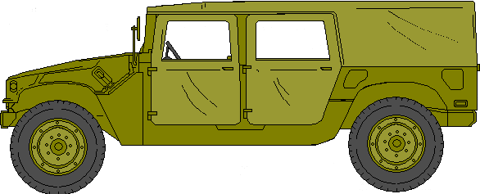
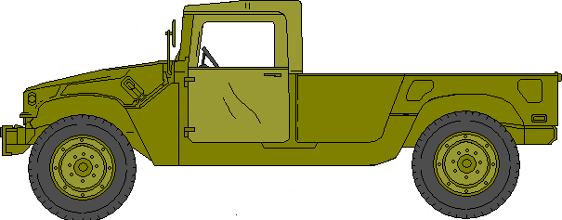
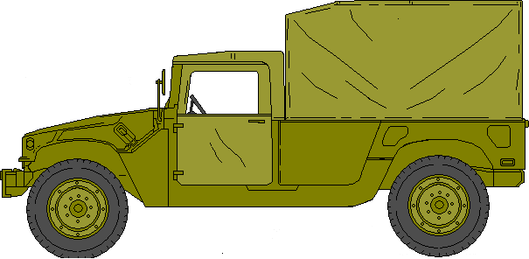
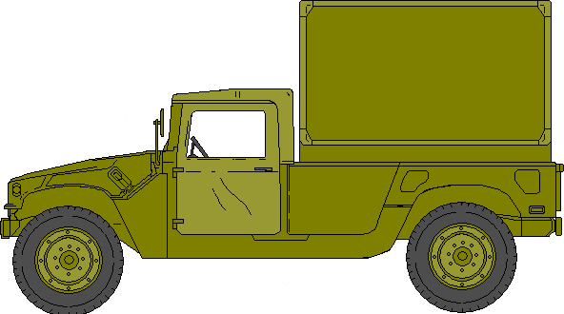
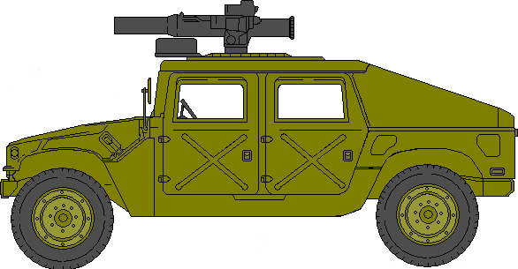
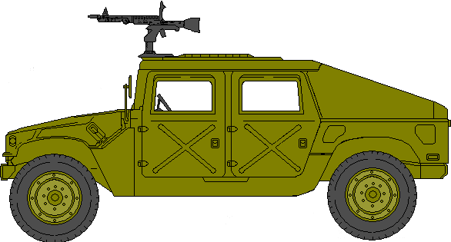
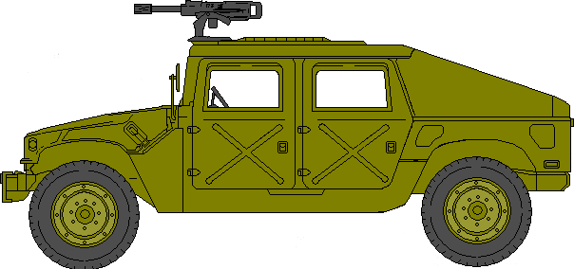
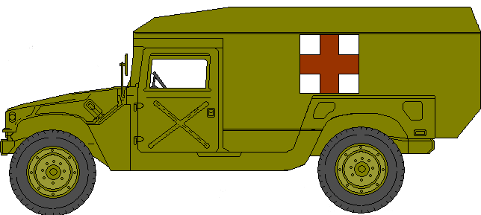
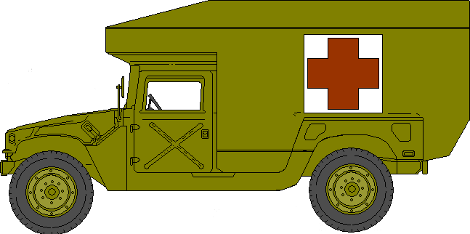
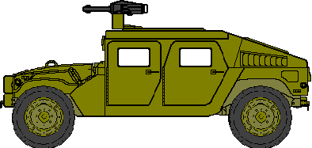
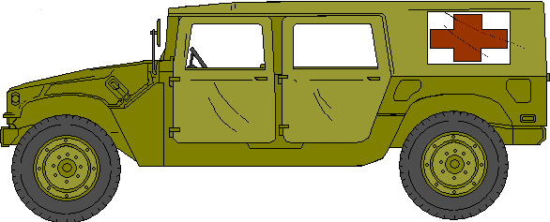
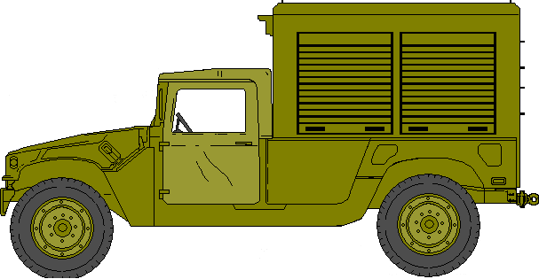
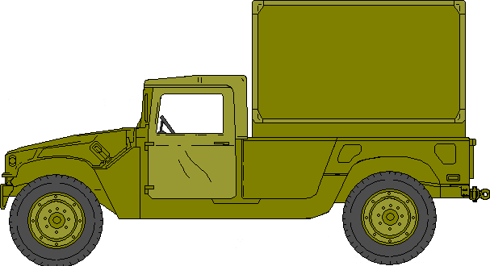
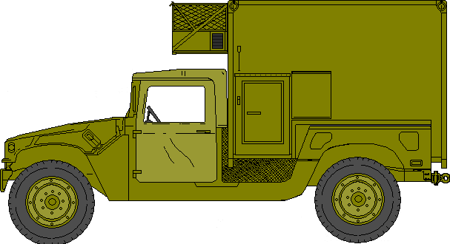
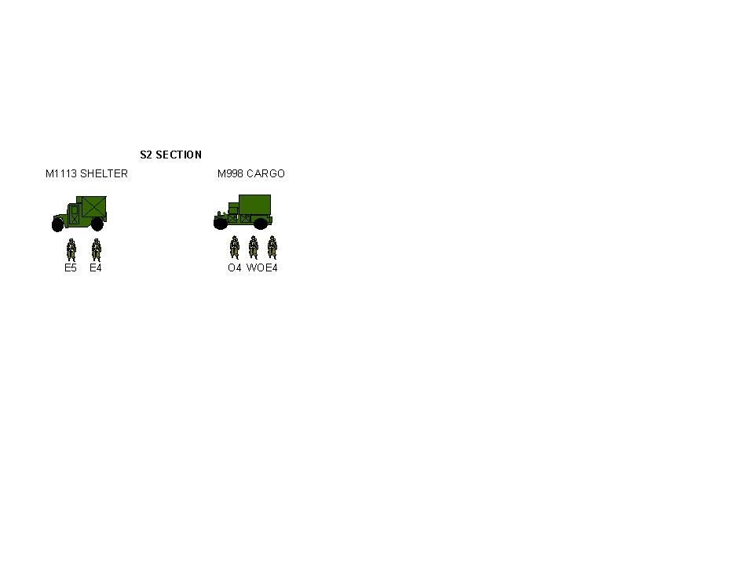
HMMWV
HMMWV, CGO/TRP CARRIER: M998A1
w/4 PAX TOP
HMMWV, CGO/TRP CARRIER: M998A1
w/4 PAX EXT TOP
HMMWV, CGO/TRP CARRIER: M1038A1
w/2 PAX TOP
HMMWV, CGO/TRP CARRIER: M1038A1
w/2 PAX TOP & CARGO COVER
HMMWV, SHELTER CARRIER: M1037
w/S250 SHELTER
HMMWV, TOW CARRIER: M966
HMMWV, ARMT CARRIER, ARMORED: M1025A1
w/M60, 7.62MM MACHINE GUN MTD
HMMWV, ARMT CARRIER, ARMORED: M1026A1
w/MK19 GRENADE LAUNCHER MTD
HMMWV, AMBULANCE: M1035
2 LITTER, SOFT TOP
HMMWV, AMBULANCE, ARMD: M996
2 LITTER
HMMWV, AMBULANCE, ARMD: M997
4 LITTER
HMMWV UP-ARMD, EXP CAP
M1114 w/MK19
HVY HMMWV: M1097A2
(MODDED) ORD CMT
HVY HMMWV: M1097A2
w/S-250 SHELTER
HVY HMMWV: M1097A2
w/SICPS SHELTER

Slide 3
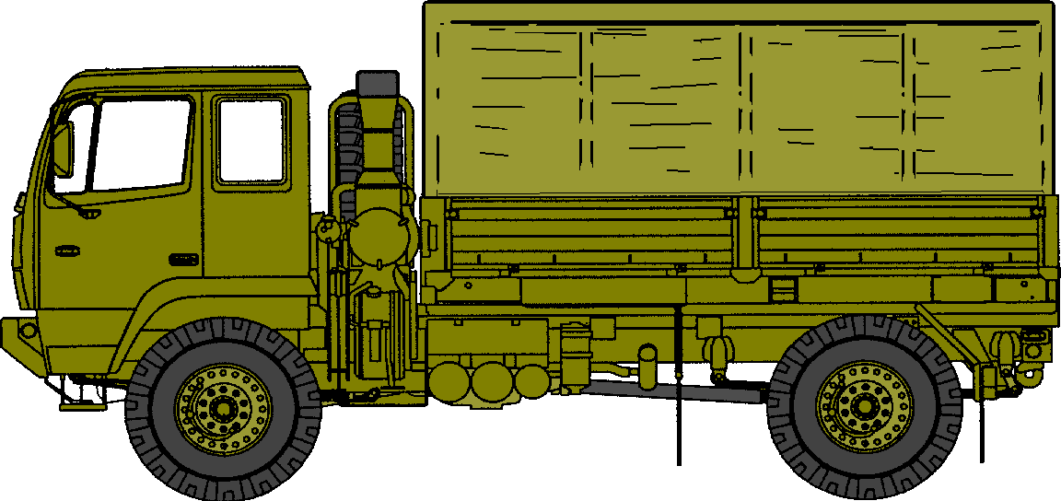


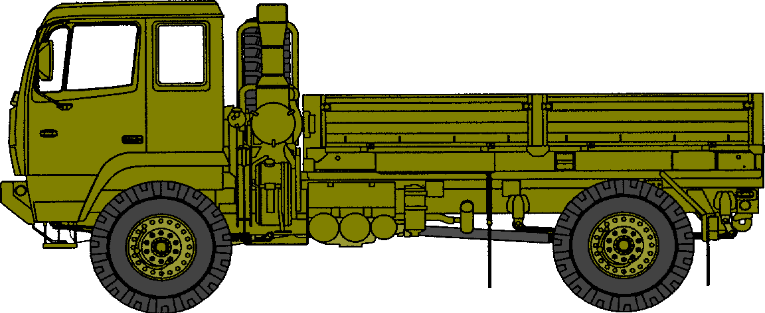
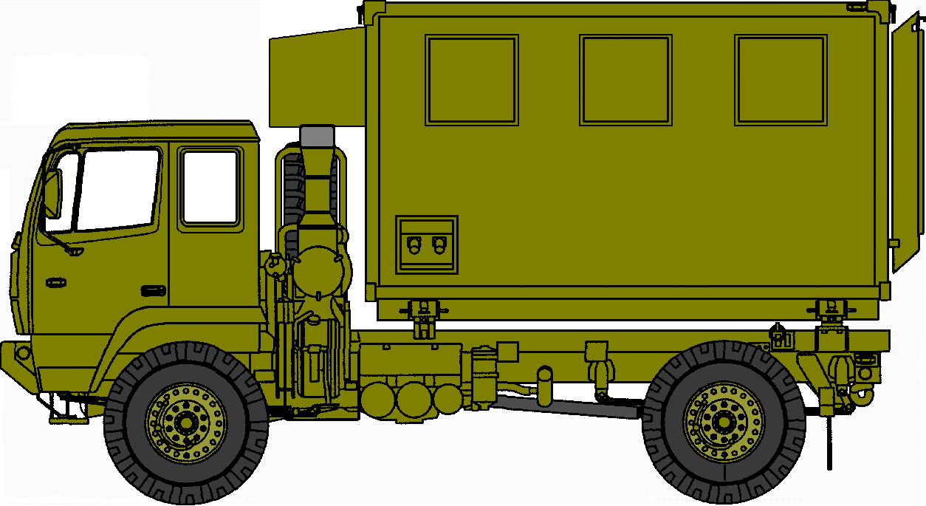
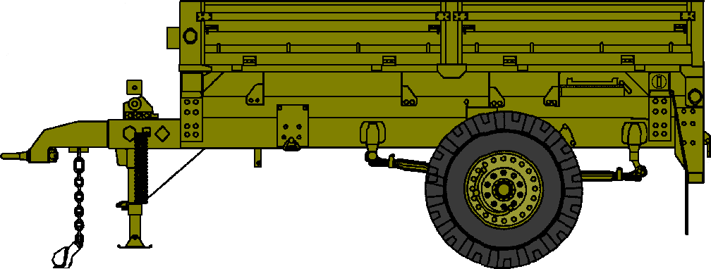
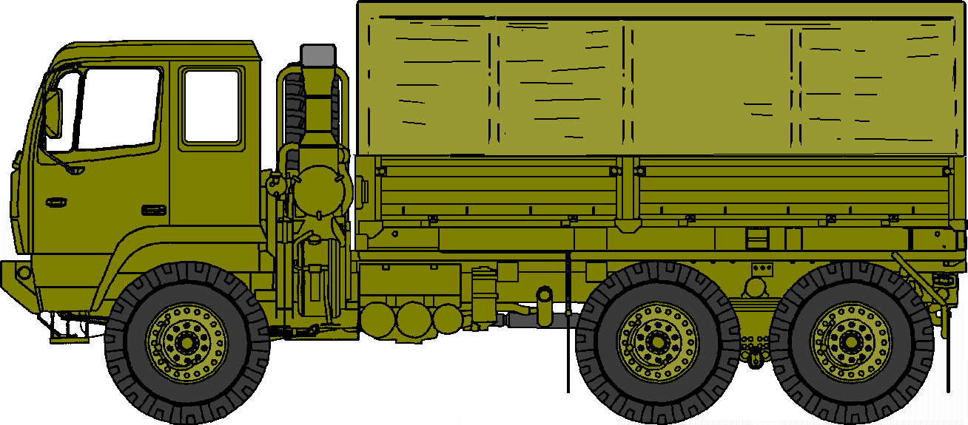
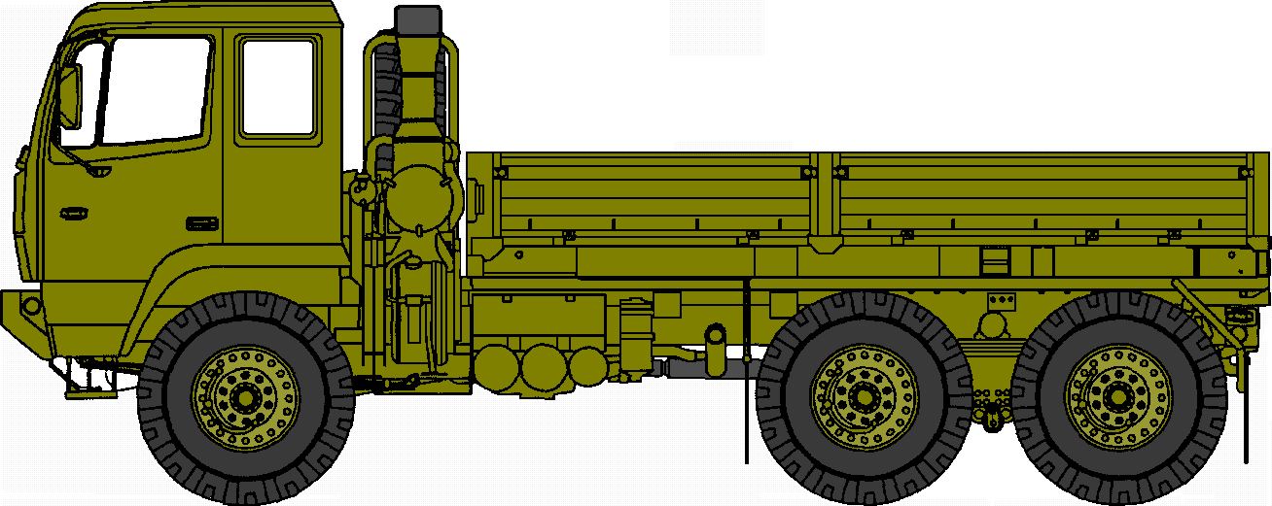

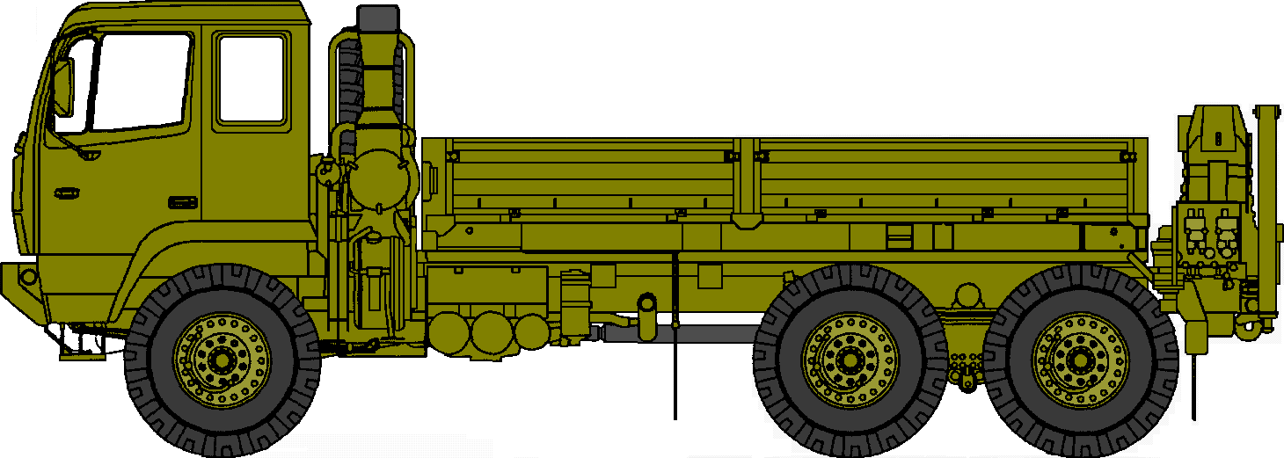
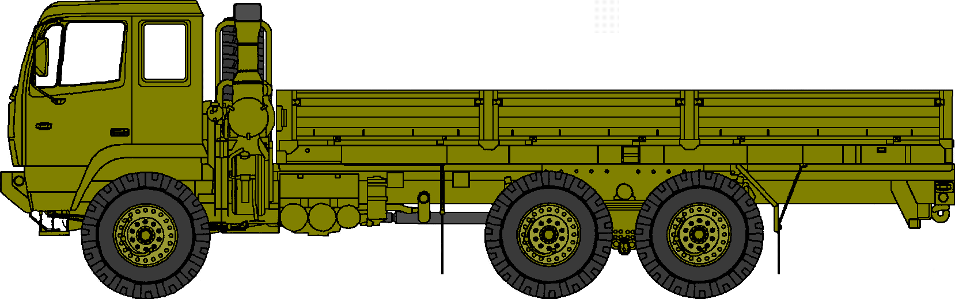
FMTV
TRK CARGO, LMTV: M1078
TRK CARGO, LMTV: M1078
w/CANVAS CARGO TOP
TRK CARGO, LMTV: M1078
w/S-280 SHELTER
LMTV VAN: M1079
TRAILER, CGO, LMTV DROPSIDE:
M1082
TRK CARGO, MTV: M1083
TRK CARGO, MTV: M1083
w/CANVAS CARGO TOP
TRK CARGO, MTV: M1083
w/S-280 SHELTER
TRK CARGO, MTV: M1083
w/HEIGHT REDUCEABLE SHELTER
TRK CARGO, MTV w/MHE: M1084
TRK CARGO, MTV, LWB : M1085

Slide 4
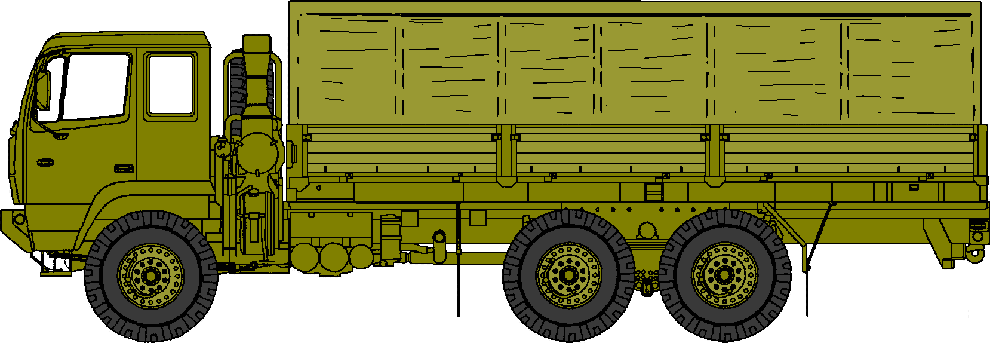

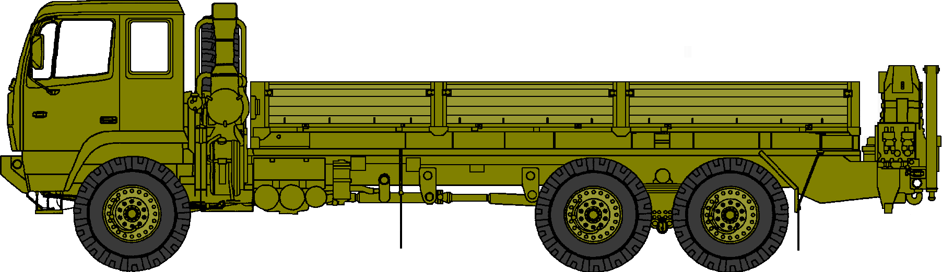
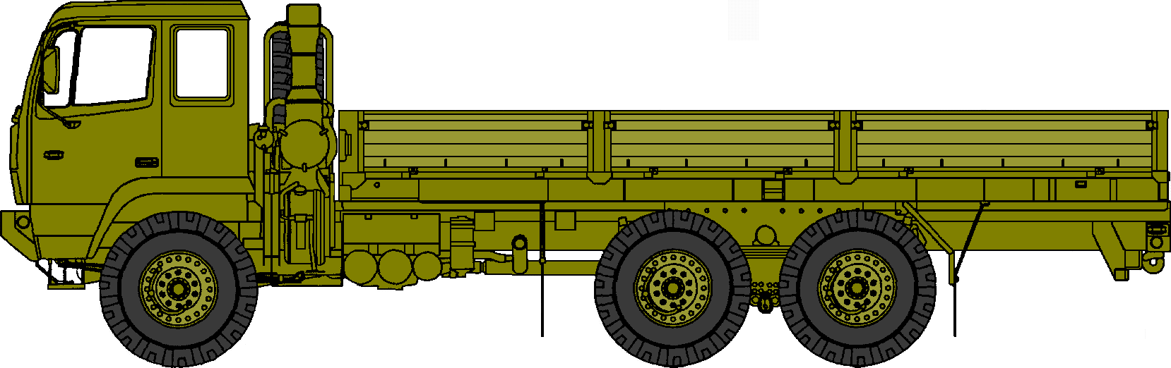
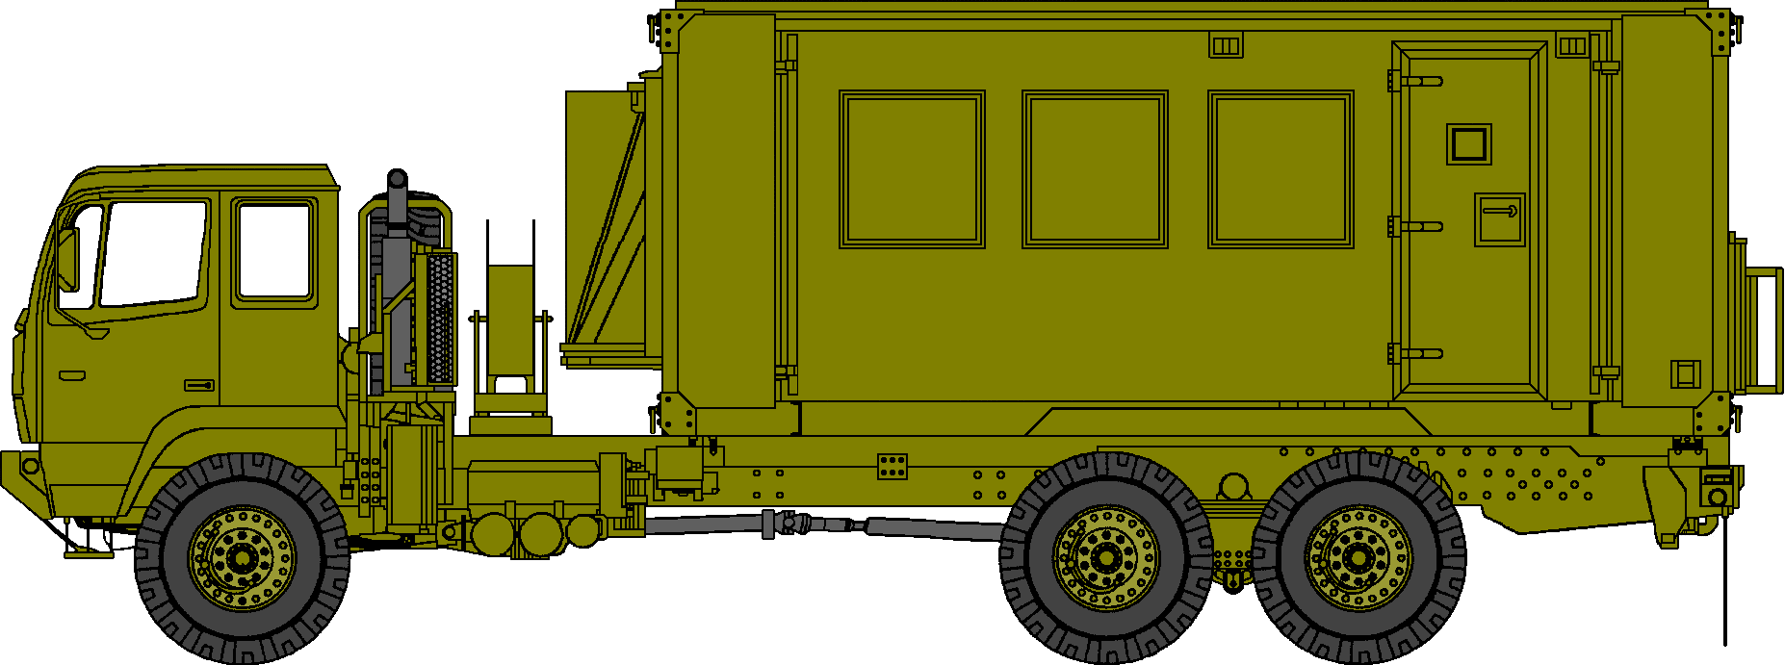
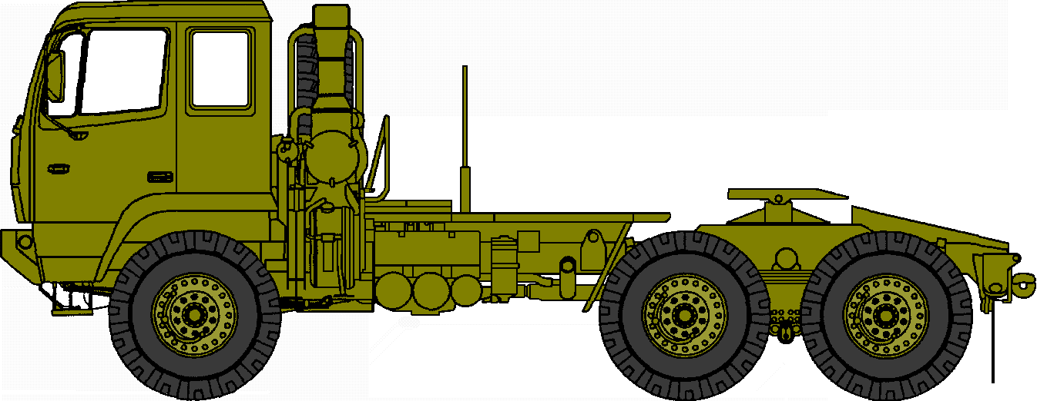
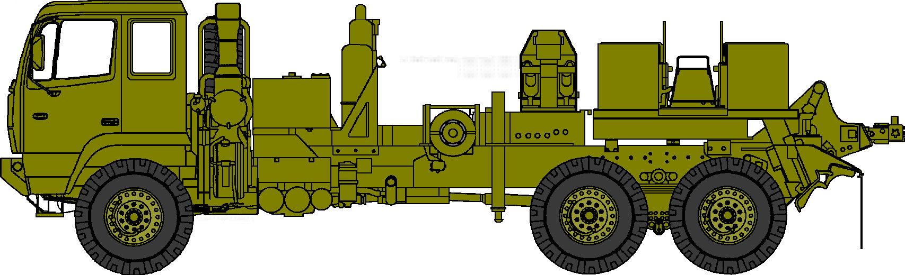
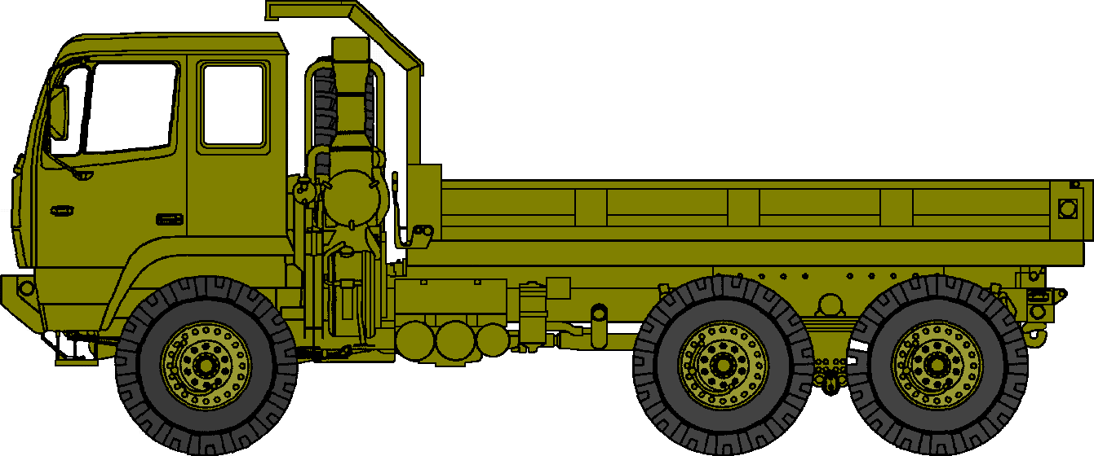
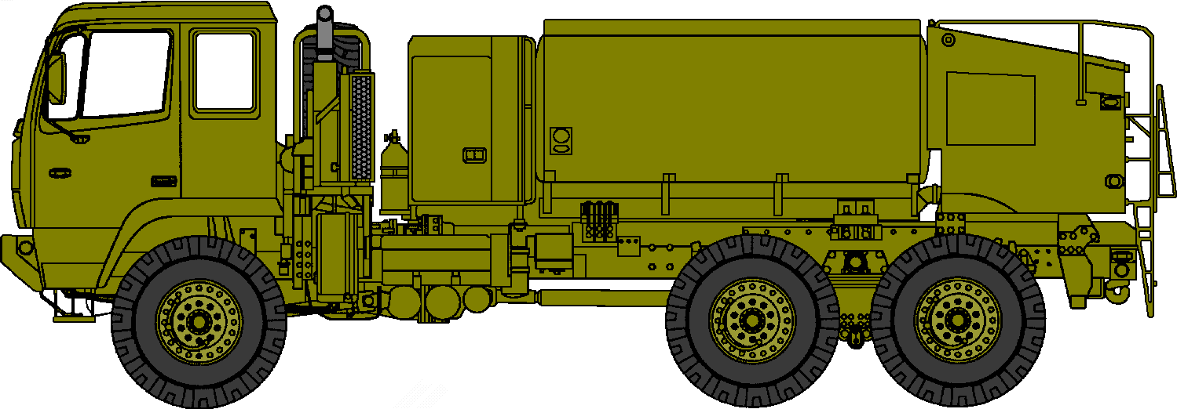
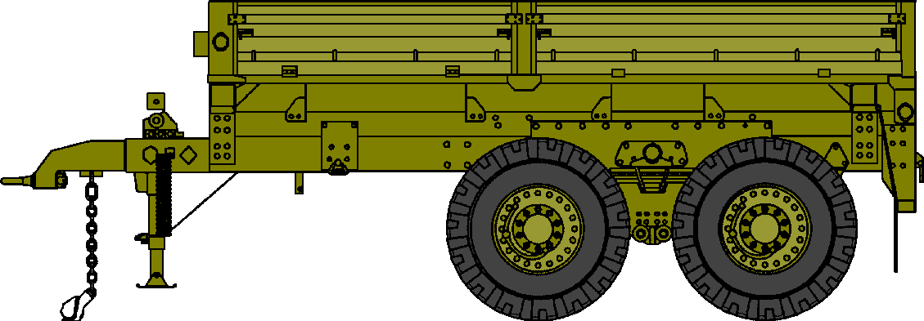
FMTV
TRK CARGO, MTV, LWB: M1085
w/CANVAS CARGO TOP
TRK CARGO, MTV, LWB: M1085 w/S-280 SHELTER
TRK CARGO, MTV, LWB w/MHE: M1086
TRK, VAN EXPANSIBLE, MTV: M1087
TRK TRACTOR, MTV: M1088
TRK WRECKER, MTV: M1089
TRK 5 TON DUMP, MTV: M1090
TRK TANK POL, MTV, 1500 GAL: M1091
TRAILER, CGO, MTV DROPSIDE: M1095

Slide 5
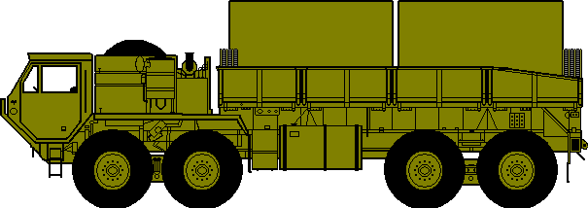
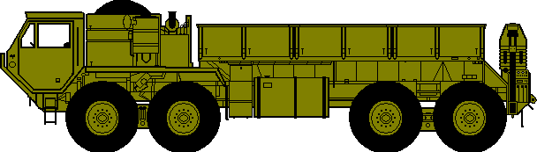
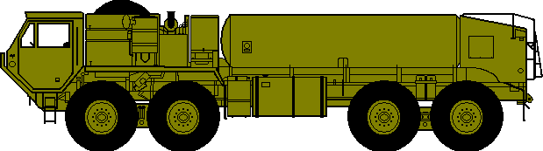
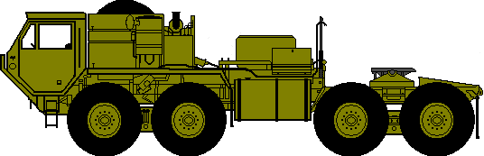
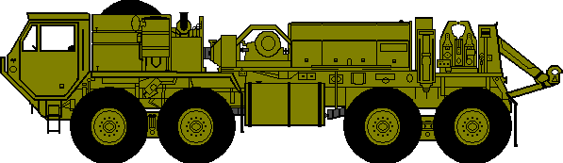
HEMTT’S
TRUCK, CGO, HEMTT, w/MHE (LT CRANE): M977 TRUCK, CGO, HEMTT
w/MHE (MED CRANE): M985
TRUCK, ELECT POWER PLANT , HEMTT: M977EPP
POTABLE WATER ONLY
FLAMMABLE
NO SMOKING WITHIN 50 FEET
TRUCK, POTABLE WATER SERVICEING, HEMTT,
M978
TRUCK, TANK FUEL SERVICEING, HEMTT,
2500 GAL: M978
TRUCK, TRACTOR, HEMTT: M983
TRUCK, WRECKER, HEMTT: M984A1

Slide 6
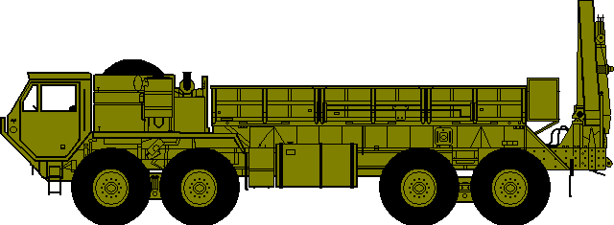
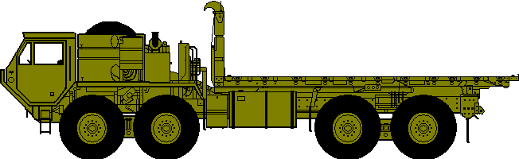




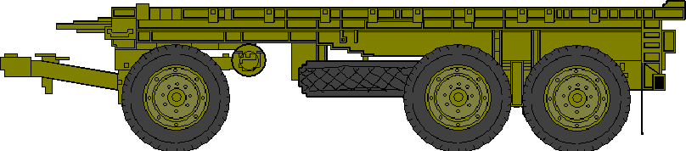
HEMTT’S
TRUCK, GUIDED MISSILE TRANSPORTER, HEMTT: M985GMT
TRUCK, HEMTT-LHS: M977 (XM-1120)
MECC
TRUCK, CGO, HEMTT- LHS
w/ 20 FT CONTAINER
TRUCK, CGO, HEMTT- LHS
w/MECC
TRUCK, CGO, HEMTT- LHS
w/FRS (NOTIONAL)
TRUCK, CGO, HEMTT- PLS
TRAILER, PLS 16 1/2 TON 8X20
M-1076

Slide 7
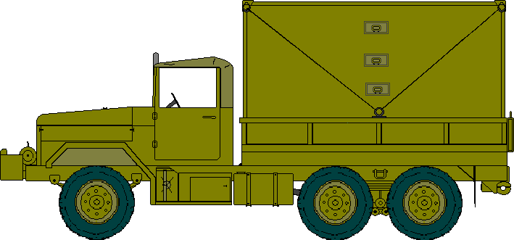
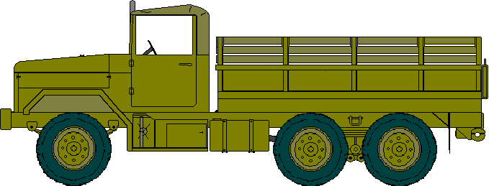
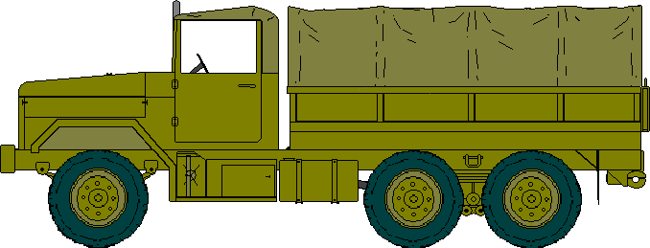
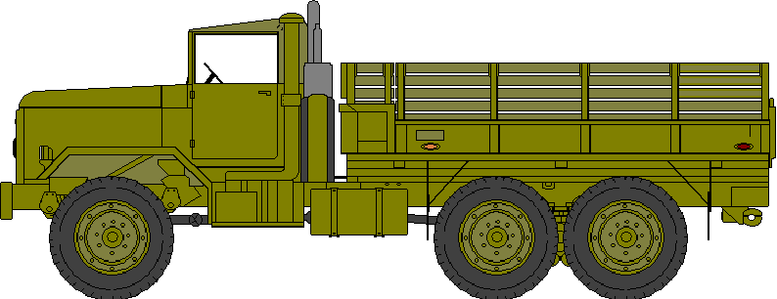
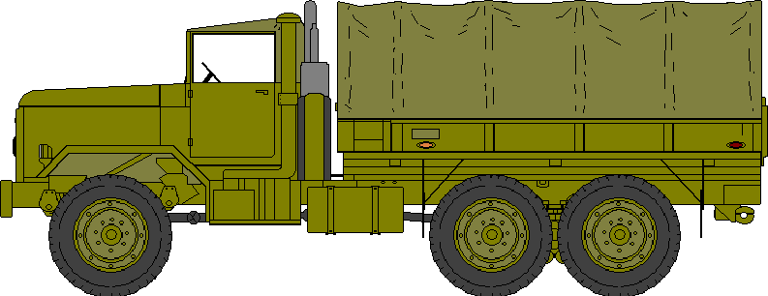
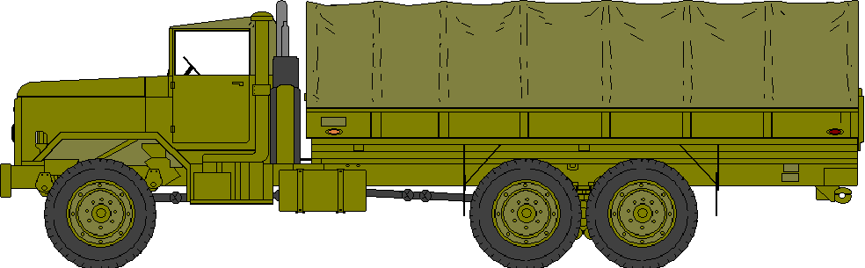
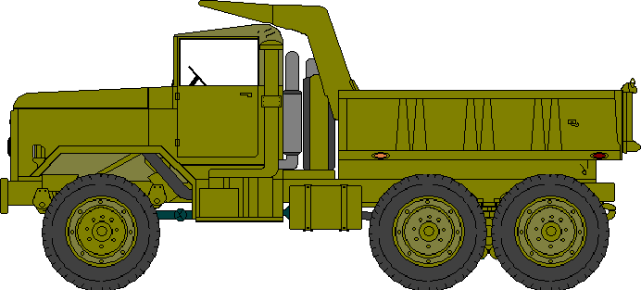
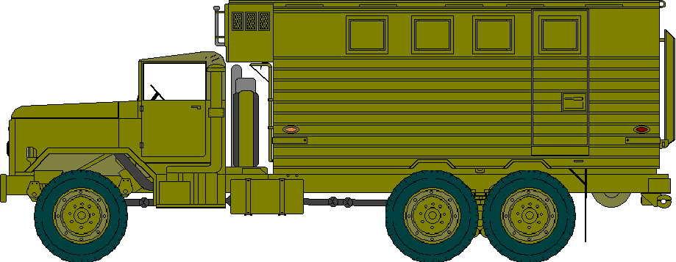
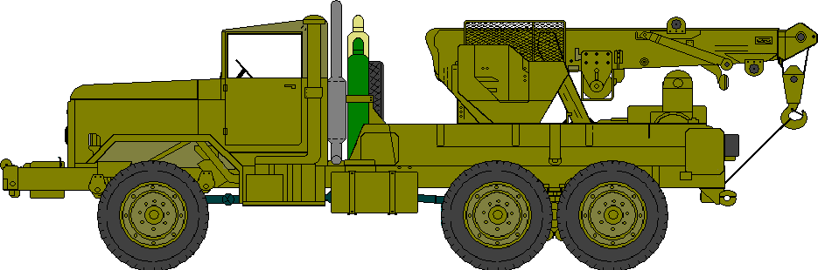
M35 SERIES 2 1/2 TON VEHICLES
TRUCK, CARGO, 2 1/2 TON: M35A2
TRUCK, CARGO, 2 1/2 TON: M35A2 w/CANVAS
M939 SERIES 5 TON VEHICLES
TRUCK, CARGO, 5 TON: M923A1
TRUCK, CARGO, 5 TON: M923A1 w/CANVAS
TRUCK, CARGO, 5 TON LWB: M924A1 w/CANVAS
TRUCK, DUMP, 5 TON: M929A1
TRUCK, VAN EXPANSIBLE, 5 TON 6x6: M934
TRUCK, WRECKER, 5 TON, 6X6: M936A1

Slide 8







M931 - TRUCK, TRACTOR, 5 TON
TRUCK, TRACTOR, 5TON: M931
FLAMMABLE
NO SMOKING WITHIN 50 FEET
M931 TRACTOR w/SEMITRAILER TANKER, 5000 GAL, M131
M931 TRACTOR w/ SEMITRAILER FLATBED,
CONTAINER TRANSPORT (30FT, 22.5T): M871A2
M931 TRACTOR w/ SEMITRAILER, BREAKBULK (30FT, 22.5T): M871A2
M931 TRACTOR w/M871A2 SEMITRAILER FLATBED
(30FT, 22.5T) & 20 FT CONTAINER

Slide 9











TRUCK, TRACTOR, M-915 SERIES, 14-20 TON
TRUCK, TRACTOR, LINEHAUL
14 TON, 6X4: M915A1
TRUCK, TRACTOR, LIGHT EQUIP TRANSPORT 14 TON, 6X6: M916 (LET)
TRUCK, TRACTOR, MEDIUM EQUIP TRANSPORT 20 TON, 8X6: M920 (MET)
M915 TRACTOR w/ SEMITRAILER, FLATBED,40 FT, 34T: M872
M916 (LET) TRACTOR w/ SEMITRAILER, LOWBED, 25 TON: M172A1
M920 (MET) TRACTOR w/SEMITRAILER, LOWBED, 40 TON: M870A1

Slide 10







HET
TRUCK, TRACTOR, COMMERCIAL, HEAVY EQUIPMENT TRANSPORT
(C-HET): M911
TRUCK, TRACTOR, HEAVY EQUIPMENT TRANSPORT
(HET): M1070
TRUCK, TRACTOR, C-HET w/SEMITRAILER, LOWBED, 60 TON: M947
TRUCK, TRACTOR, HET w/SEMITRAILER, LOWBED: M1000
TRUCK, TRACTOR,HET w/M1000 SEMITRAILER & M1A1 ABRAMS MAIN BATTLE TANK

Slide 11





SEMITRAILERS
FLAMMABLE
NO SMOKING WITHIN 50 FEET
SEMITRAILER VAN: PARTS STORAGE 6 TON
M749/M750
SEMITRAILER TANKER, 5000 GAL, BULK HAUL :
M967A1
FLAMMABLE
NO SMOKING WITHIN 50 FEET
SEMITRAILER VAN: SUPPLY 12 TON
M129A3
SEMITRAILER TANKER, 5000 GAL, FUEL DISPENSING,
AUTOMOTIVE - M969A1
AIRCRAFT - M970A1
FLAMMABLE
NO SMOKING WITHIN 50 FEET
ELECTRONICS SHOP SEMITRAILER MTD:
ASM189A/ASM190A
SEMITRAILER TANKER, 5000 GAL:
M131
SEMITRAILER, BREAKBULK/CONTAINER TRANSPORTER
30FT; 22 1/2 TON: M871A2

Slide 12


SEMITRAILERS
SEMITRAILER LOWBED: 25 TON
M172A1
SEMITRAILER, FLATBED 40FT; 34 TON: M872A3
SEMITRAILER LOWBED: 40 TON
M870A1
SEMITRAILER LOWBED: 60 TON
M747
SEMITRAILER LOWBED, WRECKER: 12 TON
M270A1

Slide 13













TRAILERS
TRAILER,CARGO HIGH MOBILITY, 3/4T - M1101 & 1 1/4T - M1102
TRAILER, CARGO, 11/2T,
M-105A2
TRAILER, WATER, 400 GAL
M-107A2
MKT
TRAILER, WELDING SET
MICLIC: MTD ON
M200A1 TRAILER
TRAILER, AMMUNITION: 1.5 TON
M332
TRAILER, BOLSTER, GP 4T
M-796A1
TRAILER, MTV: M-1095
w/FUEL POD MTD
FLOODLIGHT SET
TRAILER MTD
TRAILER, GEN SET, 5 KW
TQG: PU-798
TRAILER, GEN , 15 KW
TQG: PU-802
TRAILER, GEN , 30 KW/ 60KW
PU-803 & PU-805

Slide 14












ARMOR VEHICLES
MAIN BATTLE TANK:
M-1A1 ABRAMS
ARMORED GUN SYSTEM
(AGS): M8
BRADLEY INFANTRY/CAVALRY
FIGHTING VEHICLE : M-2 (IFV); M-3 (ICV)
BRADLEY STINGER FIGHTING VEHICLE :
M-6 (LINEBACKER)
BRADLEY FIRE SUPPORT VEHICLE :
M-7 (BFIST)
INTERIM ARMORED VEHICLE (IAV)
(NOTIONAL)
APC: M-113A3
MORTAR TRACK: M-106
ARMORED SECURITY VEHICLE
(ASV): M1117
LIGHT RECOVERY VEHICLE,
FULLY TRACKED: M-578A1
RECOVERY VEHICLE, FULLY TRACKED: M-88A1
RECOVERY VEHICLE, FULLY TRACKED: M-88A2
“HERCULES’

Slide 15




ARTILLERY VEHICLES & PLATFORMS
HOWITZER SP 155: M109A1
FAASV: M992A2
HOWITZER, LIGHT, TOWED 105MM: M-101
HOWITZER, MEDIUM, TOWED 155MM: M-198

Slide 16










ENGINEER VEHICLES & PLATFORMS
TRACTOR, WHLD DSL 4X4
w/EXCAVATOR: FLU-419
TRACTOR, FULL TRK, LT ENGR
DEUCE
CARRIER, CARGO, FULL TRK, 6 TON
M548A1
GRADER: M130G
SCOOP LOADER: MW24C
EXCAVATOR, COMBAT
M9 ACE
COMBAT ENGINEER VEHICLE (CEV)
M728
COUNTER OBSTACLE VEHICLE, HVY
(GRIZZLEY)
LAUNCHER w/HAB (WOLVERINE)

Slide 17








MISCELLANEOUS ITEMS
FORKLIFT 4K
FORKLIFT 6K
MOBILE EXPANDIBLE CONTAINER CONFIG. (MECC)
FORKLIFT, VARIABLE REACH
ROUGH TERRAIN: 6K
FORKLIFT, VARIABLE REACH
ROUGH TERRAIN: ATLAS 10K
CONTAINER 20FT
FORKLIFT, EXTENDED REACH
50K
CONTAINER 40FT
CUCV: M1009
CUCV: M1008A1

Slide 18



CRANES
CRANE, TRUCK MOUNTED, 4 TON
AIRCRAFT MAINT, MDL # RT41AA (SCAMP)
CRANE, ROUGH TERRAIN, 7 1/2 TON
KOEHRING
CRANE, TRUCK MOUNTED, 40 TON
CONTAINER HANDLER, MDL # R875CC

